Slide 1


AI Powered Marketing Portfolio

Slide 2

CONTENTS
1. Leveraging AI to create tailored marketing strategies
2. Project Overview
3. System Architecture
4. Workflow
5. Technology Stack
6. Key Features
7. Demo – User Flow
8. Code Walkthrough
9. Future Improvements
10. Conclusion

Slide 3

01
Leveraging AI to create tailored marketing strategies

Slide 4

Leveraging AI to create tailored marketing strategies
Your Name

Slide 5

02
Project Overview

Slide 6




Project Overview
Objective: Build a portfolio web app that demonstrates how AI can generate marketing proposals.
Core Features:
AI-generated proposals
Clean user interface
Expandable for case studies and client presentations
Stack Used:
Frontend
HTML, CSS, JavaScript
Backend
Node.js, Express.js
AI Integration
OpenAI API

Slide 7

03
System Architecture

Slide 8
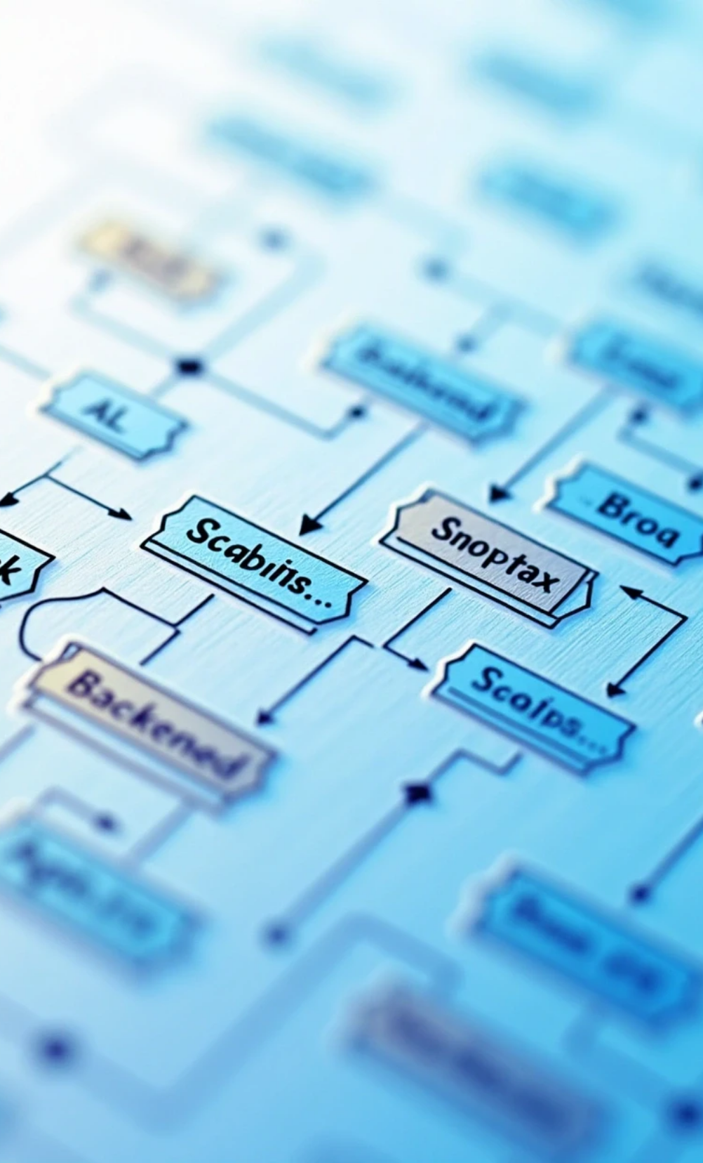
System Architecture
Frontend (Public folder): index.html, styles.css, scripts.js
Backend (server.js): Express server serving frontend and handling API routes
API Route (generateProposal.js): Calls AI model and returns proposal
Environment (.env): Securely stores PORT and API keys

Slide 9

04
Workflow

Slide 10




Workflow
User Input
API Request
AI Processing
Output Display
Enter project details
Request sent to /api/generateProposal
Backend calls AI API, generating a tailored outline
Proposal shown dynamically in the frontend

Slide 11

05
Technology Stack

Slide 12




Technology Stack
Node.js & Express.js – backend server
Axios – API calls
CORS & body-parser – request handling
Dotenv – environment variable management
Frontend – Responsive HTML/CSS + vanilla JS

Slide 13


06
Key Features

Slide 14

Key Features
✅ AI-powered marketing proposal generation
✅ Simple & responsive UI
✅ Scalable – can add case studies, analytics, client dashboards
✅ Secure API key handling (via .env)

Slide 15

07
Demo – User Flow

Slide 16
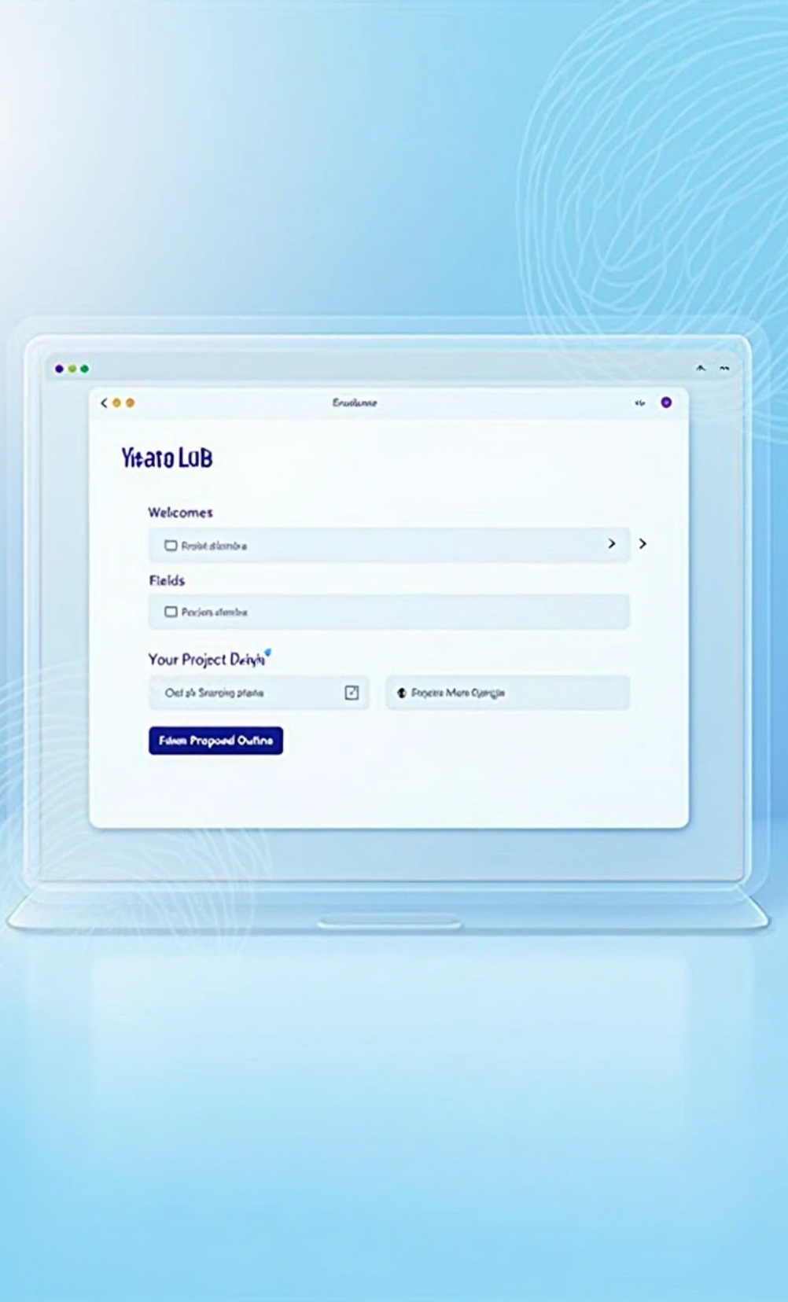



Demo – User Flow
Open web app → Home page loads
Input project details
Click 'Request Proposal Outline'
Proposal generated and displayed

Slide 17

08
Code Walkthrough

Slide 18





Code Walkthrough
server.js
package.json
Starts Express server, serves frontend, defines API endpoint
Lists dependencies
.env
Frontend
Stores environment variables
index.html + scripts.js manage UI and API calls

Slide 19

09
Future Improvements

Slide 20

Future Improvements
📊 Add case studies section with examples
🎯 Include analytics dashboard
🌍 Deploy to Netlify / Vercel
🔐 Add authentication for clients
🏆 Gamify proposal success rates with AI scoring

Slide 21

10
Conclusion

Slide 22




Conclusion
This project demonstrates how AI can assist in marketing strategy development.
Live portfolio project to impress clients and employers
Scalable for future features like multi-language, PDF export, dashboards
AI-powered, user-friendly, and professional

Slide 23

Thank You

